Slide 1
Requirement Engineering

Slide 2
Requirements engineering processes
The processes used for RE vary widely depending on the application domain, the people involved and the organisation developing the requirements.
However, there are a number of generic activities common to all processes
Requirements elicitation and analysis; (next)
Requirements validation; (see previous slides)
Requirements management. (reading, last slides)
RE is an iterative activity in which these processes are interleaved.
Notes:
RE processes in Ch2: assessing if the system is useful to the business
(feasibility study), discovering requirements (elicitation and analysis), converting
these requirements into some standard form (specification), and checking that the
requirements actually define the system that the customer wants (validation

Slide 3
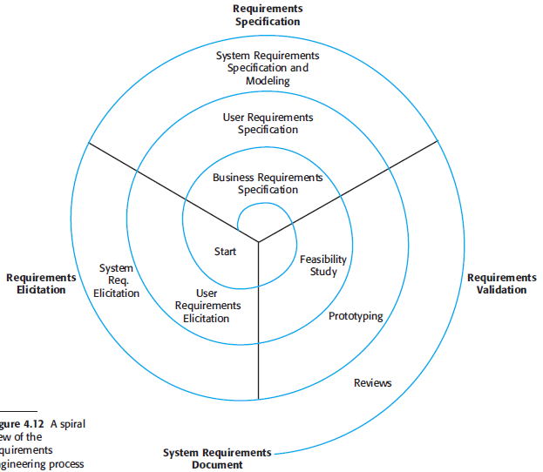
A spiral view of the requirements engineering process

Slide 4
Feasibility studies
A feasibility study decides whether or not the proposed system is worthwhile
A short focused study that checks
If the system contributes to organizational objectives
If the system can be engineered using current technology and within budget
If the system can be integrated with other systems that are used

Slide 5
Feasibility study implementation
Based on information assessment (what is required), information collection and report writing
Questions for people in the organisation
What if the system wasn’t implemented?
What are current process problems?
How will the proposed system help?
What will be the integration problems?
Is new technology needed? What skills?
What facilities must be supported by the proposed system?

Slide 6
Requirements elicitation and analysis
Technical staff working with customers to find out about
the application domain,
the services that the system should provide and
the system’s operational constraints.
May involve end-users, managers, engineers involved in maintenance, domain experts, trade unions, etc. These are called stakeholders.

Slide 7
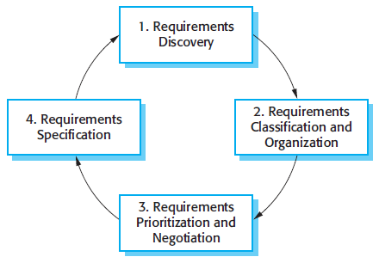
The requirements elicitation and analysis process

Slide 8
Requirements elicitation and analysis Process activities
Requirements discovery
Interacting with stakeholders to discover their requirements. Domain requirements are also discovered at this stage.
Requirements classification and organisation
Groups related requirements and organises them into coherent clusters.
Prioritisation and negotiation
Prioritising requirements and resolving requirements conflicts.
Multiple stakeholders result in conflicts, so resolve them
Requirements specification
Requirements are documented and input into the next round of the spiral.

Slide 9
Problems of requirements elicitation & analysis
Stakeholders don’t know what they really need.
Stakeholders express requirements in their own terms.
Different stakeholders may have conflicting requirements.
Organisational and political factors may influence the system requirements.
The requirements change during the analysis process. New stakeholders may emerge and the business environment may change.
We need requirement management

Slide 10
Requirements discovery
The process of gathering information about the required and existing systems and distilling the user and system requirements from this information.
Interaction is with system stakeholders from managers to external regulators. Examples:
Interviews
Observations
Scenarios or prototypes
Systems normally have a range of stakeholders.

Slide 11
Stakeholders in the MHC-PMS
Doctors who are responsible for assessing and treating patients.
Nurses who coordinate the consultations with doctors and administer some treatments.
Patients whose information is recorded in the system.
Medical receptionists who manage patients’ appointments.
IT staff who are responsible for installing and maintaining the system.
A medical ethics manager who must ensure that the system meets current ethical guidelines for patient care.
Health care managers who obtain management information from the system.
Medical records staff who are responsible for ensuring that system information can be maintained and preserved, and that record keeping procedures have been properly implemented.

Slide 12
Interviewing
Formal or informal interviews with stakeholders are part of most RE processes.
Types of interview
Closed interviews based on pre-determined list of questions
Open interviews where various issues are explored with stakeholders.
Effective interviewing
Be open-minded, avoid pre-conceived ideas about the requirements and are willing to listen to stakeholders.
Prompt the interviewee to get discussions going using a startup question, a requirements proposal, or by working together on a prototype system.
Notes:
In addition to system stakeholders, we have already seen that requirements may
also come from the application domain and from other systems that interact with the
system being specified. All of these must be considered during the requirements
elicitation process

Slide 13
Interviews in practice
Normally a mix of closed and open-ended interviewing.
Interviews are good for getting an overall understanding of what stakeholders do and how they might interact with the system.
Interviews are not good for understanding domain requirements
Requirements engineers cannot understand specific domain terminology;
Some domain knowledge is so familiar that people find it hard to articulate or think that it isn’t worth articulating.
Interviews are effective BUT use in conjunction with other requirement elicitations techniques

Slide 14
Ethnography
A social scientist spends a considerable time observing and analysing how people actually work.
People do not have to explain or articulate their work.
Social and organisational factors of importance may be observed.
Requirements derived from the way that people actually work rather than the way the process definitions suggest that they ought to work.
Basis: Work is usually richer and more complex than suggested by simple system models.
Ethnography is effective for understanding existing processes
problems with ethnography:
it studies existing practices which may have some historical basis which is no longer relevant.
cannot identify new features that should be added to a system.

Slide 15
Scenarios
Scenarios are real-life examples of how a system can be used.
They should include
A description of the starting situation;
A description of the normal flow of events;
A description of what can go wrong;
Information about other concurrent activities;
A description of the state when the scenario finishes.
Scenario-base elicitation involves working with stakeholders to identify scenarios and to capture details to be included in these scenarios.
stakeholders can understand and criticize a scenario of how they might interact with a software system.
Scenarios may be written as text, supplemented by diagrams, screen shots, etc. Alternatively, a more structured approach such as event scenarios or use cases may be used

Slide 16
Scenario for collecting medical history in MHC-PMS

Slide 17
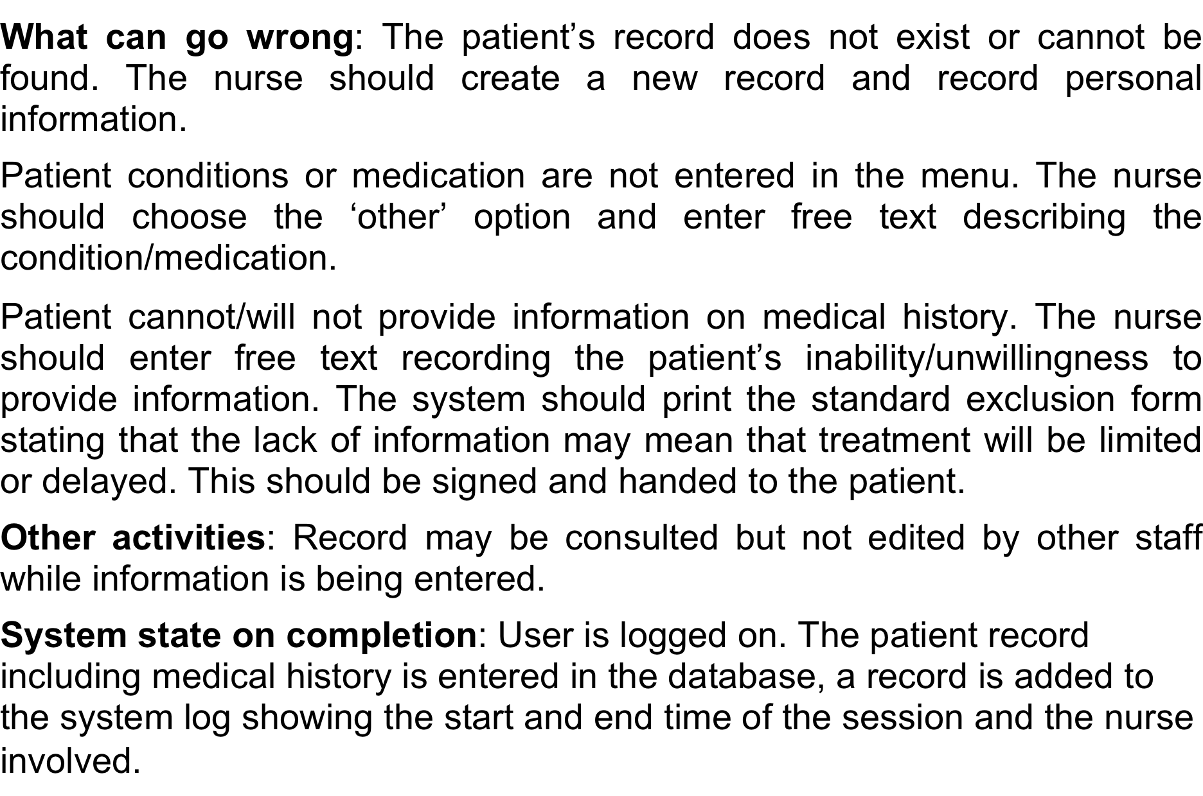
Scenario for collecting medical history in MHC-PMS

Slide 18
Use cases
Use-cases are a scenario based technique in the UML which identify the actors in an interaction and which describe the interaction itself.
A set of use cases should describe all possible interactions with the system.
De facto standard in object oriented analysis
Use case diagram accompanied with a use case specification
High-level graphical model supplemented by more detailed tabular description
UML Sequence diagrams may be used to add detail to use-cases by showing the sequence of event processing in the system.

Slide 19
Use cases
Use cases document the behavior of the system from the users’ point of view.
User: anything external to the system
A use case involves a sequence of interactions between the initiator and the system
In a use case, the system is considered as a black-box. We are only interested in externally visible behavior
“Getting started: Using use cases to capture requirements”, James Rumbaugh, 1994
“Using UML”, Perdita Stevens, Rob Pooley, 2000

Slide 20
Use Cases
Text stories, widely used to discover and record requirements
Stories of some actor using a system to meet goals
A simple and familiar model that many people, especially non-technical, can easily relate to
There is nothing object oriented about use cases
kind of requirements input for the design steps.
They influence and will be input to many subsequent artifacts

Slide 21
Use Cases are not Diagrams
Use cases are not only diagrams, they are text
Use case modeling is primarily an act of writing text
But a short time drawing a use case diagram provides a context for:
identifying use cases by name
creating a “context diagram”
Notes:
The use case model may include a UML use case diagram to show the names of use cases and actors, and their relationships
Context Diagram of a system and its environment

Slide 22
Use Case: Definition
A set of use case instances, where each instance is a sequence of actions a system performs that yields an observable result of value to a particular actor

Slide 23
A Use Case for NextGen POS
Process Sale: A customer arrives at a checkout with items to purchase. The cashier uses the POS system to record Each purchased item. The system presents a running total and line-item details. The customer enters payment information, which the system validates and records. The system updates inventory. The customer receives a receipt from the system and then leaves with the items.

Slide 24
Use cases diagrams: Actors
An actor is a role played by an outside entity that interacts directly with the system
An actor can be a human, or a machine or program
An actor is something with behavior
Guideline questions for identifying actors
Which user groups are supported by the system to perform their work?
Which user groups execute the system's main functions?
Which user groups perform secondary functions, such as maintenance and administration?
With what external hardware or software system will your system interact?
Librarian

Slide 25
Actors
An actor is something with behavior
Person identified by role, computer system, or organization
Primary Actor: has goals fulfilled through using services of the system (e.g., cashier)
Why identify? To find user goals, which drive the use cases
Supporting Actor: Provides a service to the system (e.g., The automated payment authorization service)
Why identify? To clarify external interfaces and protocols
Offstage Actor: Has an interest in the behavior of the use case (e.g., Government tax agency)
Why Identify? To ensure that all necessary interests are identified and satisfied

Slide 26
Scenarios and Use Cases
A scenario = A use case instance
One particular story of using a system
E.g., successfully purchasing items with cash.
Each way of using the system is called a use case
A use case is a collection of related success and failure scenarios describing an actor using a system to support a goal
So, a scenario is one path through the use case
Installing
a Database
Notes:
A scenario is a specific sequence of actions and interactions between actors and the system

Slide 27
Success and Failure Scenarios Example: Handle Returns
Handle Returns
Main Success Scenario: A customer arrives at a checkout with items to return. The cashier uses the POS system to record each returned item …
Alternative Scenarios
If the customer paid by credit, and the reimbursement transaction to his/her credit account is rejected, inform the customer and pay them with cash
If the item identifier is not found in the system, notify the Cashier and suggest manual entry of the identifier code
If the system detects failure to communicate with the external accounting system, …

Slide 28
Notation
Brief: one-paragraph summary
Written during early requirements analysis, to get a quick sense of subject and scope
May take only a few minutes to create
Casual: Informal paragraph format. Multiple paragraphs that cover various scenarios
Written during early requirements analysis, to get a quick sense of subject and scope
Fully Dressed: All steps and variations are written in detail, and there are supporting sections.
After many use cases have been identified in a brief format, a few of them are written in detail at each iteration

Slide 29
A Use Case for NextGen POS
Process Sale: A customer arrives at a checkout with items to purchase. The cashier uses the POS system to record Each purchased item. The system presents a running total and line-item details. The customer enters payment information, which the system validates and records. The system updates inventory. The customer receives a receipt from the system and then leaves with the items.

Slide 30
Success and Failure Scenarios Example: Handle Returns
Handle Returns
Main Success Scenario: A customer arrives at a checkout with items to return. The cashier uses the POS system to record each returned item …
Alternative Scenarios
If the customer paid by credit, and the reimbursement transaction to his/her credit account is rejected, inform the customer and pay them with cash
If the item identifier is not found in the system, notify the Cashier and suggest manual entry of the identifier code
If the system detects failure to communicate with the external accounting system, …

Slide 31
Fully Dressed Style: A Template
Use Case Section | Comment
Use Case Name | Should be the goal as a short active verb phrase
Scope | What system is being considered black-box
Level | Summary, User-goal, or Subfunction
Primary Actor | A role name for the primary actor
Stakeholders & Interests | List of stakeholders and key interests in the use case
Preconditions | What must be true on start
Success Guarantees | What must be true on successful completion
Main Success Scenario | A typical, unconditional happy path scenario of success
Extensions | Alternate scenarios of success or failure
Special Requirements | Related non-functional requirements
Technology and Data Var. List | Varying I/O methods and data formats
Frequency of occurrence | Influences investigation, testing, and timing of implementation
Miscellaneous | Open issues

Slide 32
Number the steps (1..N)
Capitalize the actors’ names
There may be repetitions of steps (without number)
Main Success Scenario:
Customer arrives at a POS checkout with items to purchase.
Cashier starts a new sale.
Cashier enters item identifier.
System records sale line item and presents item description, price, and running total. Price calculated from a set of price rules.
Cashier repeats steps 3-4 until indicates done.
System presents total with taxes calculated.
Cashier tells Customer the total, and asks for payment
Customer pays and System handles payment
System logs completed sale and sends sale and payment information to the external accounting system and inventory system
System presents receipt
Customer leaves with receipt and goods (if any)

Slide 33
Extensions (or Alternate Flows)
Extensions indicate all other scenarios or branches, both success and failure
Below the main success scenario, for every place where the behavior branch due to a particular condition
Write the condition
Write the steps that handle it
Extension scenarios are branches from the main success scenario
Numbered with respect to main scenario’s steps
Many extensions end by simply merging back to the main success scenario
At the end of extension handling, by default the scenario merges back with the main success scenario, unless the extension indicates otherwise

Slide 34
An extension branching at step 3 is labeled 3a; it first identifies the condition and then the response
When possible, write the condition as something that can be detected by the system or an actor
Alternate extensions at step 3 are labeled 3b and so forth
Extensions:
…
3a. Invalid identifier:
1. System signals error and rejects entry
3b. There are multiple of same item category and tracking unique item identity not important:
1. Cashier can enter item category identifier and the quantity.
…

Slide 35
Extension handling can be summarized in one step, or include a sequence
A condition may occur within a range of steps
…
3-6a: Customer asks Cashier to remove an item from the purchase:
1. Cashier enters the item identifier for removal from sale
2. System displays updated running total
…

Slide 36
Sometimes a particular extension point is quite complex
…
7b. Paying by credit:
1. Customer enters their credit account information
2. System sends payment authorization request to an external Payment Authorization Service System, and requests payment approval
2a. System detects failure to collaborate with external system
1. System signals error to Cashier
2. Cashier asks Customer for alternate payment.
…
This can be a motivation to express the extension as a separate use case (subfunction level)

Slide 37
It is desirable to describe an extension condition as possible during any steps, the labels *a, *b, … can be used
…
*a: At any time, System crashes:
In order to support recovery and correct accounting, ensure all transaction sensitive state and events can be recovered at any step in the scenario
1. Cashier restarts the System, logs in, and requests recovery of prior state.
2. System reconstructs prior state
…

Slide 38
Performing Another Use Case Scenario
Sometimes, a use case branches to perform another use case scenario
Performing this second use case is shown with underlining
…
3a. Invalid item ID (not found in system):
1. System signals error and rejects entry.
2. Cashier responds to the error.
2a. …
2b. Cashier performs Find Product Help to obtain true item ID and price
…

Slide 39
Special Requirements
A non-functional requirement, quality attribute, or constraint relates specifically to a use case
Special Requirements:
Touch screen UI on a large flat panel monitor. Text must be visible from 1 meter.
Credit authorization response within 30 seconds 90% of the time
Language internationalization on the text displayed.
…

Slide 40
Technology and Data Variations List
Often there are technical variation in how something must be done
It is noteworthy to record this in the use case
Technology and Data Variations List:
3a. Item identifier entered by laser scanner or keyboard.
3b. Item identifier may be any UPC, EAN, JAN, or SKU coding scheme.
7a. Credit account information entered by card reader or keyboard.
…

Slide 41
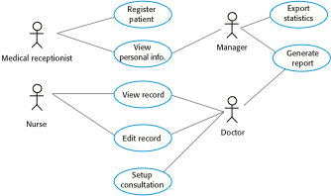
Use cases for the MHC-PMS

Slide 42
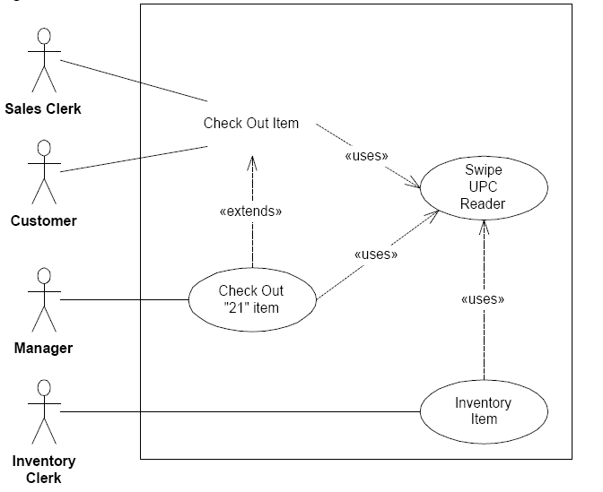

Slide 43
<<uses>> relation
When there are repetitions in the scenarios, we make a use-case instance for the repetition part. Then let the other use-cases invoke this sub-usecase instance.
E.g. payment with credit card use case
In some texts this relationship is called includes instead of uses
uses relationship permits the same behavior to be embedded in many otherwise unrelated use cases

Slide 44
Combining use cases
What does A uses B mean?
A use case uses another use case when it embeds a subsequence as a necessary part of a larger case
In some texts this relationship is called includes instead of uses
uses relationship permits the same behavior to be embedded in many otherwise unrelated use cases

Slide 45
Example
<<uses>>
Check in
for Flight
Assign Seat
<<extends>>
<<extends>>
Upgrade
Seat
Check
Baggage
use case
Flight Attendant
actor
Customer
Check in for Flight use case uses Assign Seat use case.
To perform check in, a seat must be assigned

Slide 46
<<extends>> relationship
Adds new behavior to a complete base use case
Used for adding alternative scenarios explicitly
Alternative: add a new scenario to the extension part instead
Use <<extends>> if you want to make the extension scenario explicit

Slide 47
A use case extends another use case
when it embeds new behavior into a complete base case
<<uses>>
Check in
for Flight
Assign Seat
<<extends>>
<<extends>>
Upgrade
Seat
Check
Baggage
use case
Flight Attendant
actor
Customer
Check Baggage extends the base case Check in for Flight
You do not have to check baggage to check in for flight.

Slide 48
Combining use cases
What is the difference ?
In the extends the extended use case is a valid use case by itself
The subsequence is optional
In the uses the use case which is using the other use case is not complete without it
The subsequence is mandatory

Slide 50
Requirements management
New requirements emerge as a system is being developed and after it has gone into use.
Requirements management is the process of managing (understanding and controlling) changing requirements
during the requirements engineering process and system development.
You need to keep track of individual requirements and maintain links between dependent requirements so that you can assess the impact of requirements changes.
You need to establish a formal process for making change proposals and linking these to system requirements.

Slide 51
Changing requirements
The business and technical environment of the system always changes after installation.
New hardware may be introduced, it may be necessary to interface the system with other systems, business priorities may change (with consequent changes in the system support required), and new legislation and regulations may be introduced that the system must necessarily abide by.
The people who pay for a system and the users of that system are rarely the same people.
System customers impose requirements because of organizational and budgetary constraints. These may conflict with end-user requirements and, after delivery, new features may have to be added for user support if the system is to meet its goals.

Slide 52
Changing requirements
Large systems usually have a diverse user community, with many users having different requirements and priorities that may be conflicting or contradictory.
The final system requirements are inevitably a compromise between them and, with experience, it is often discovered that the balance of support given to different users has to be changed.

Slide 53
Requirements management planning
Establishes the level of requirements management detail that is required.
Requirements management decisions:
Requirements identification Each requirement must be uniquely identified so that it can be cross-referenced with other requirements.
A change management process This is the set of activities that assess the impact and cost of changes.
Traceability policies These policies define the relationships between each requirement and between the requirements and the system design that should be recorded.
Tool support Tools that may be used range from specialist requirements management systems to spreadsheets and simple database systems.

Slide 54
Requirements change management
Deciding if a requirements change should be accepted
Problem analysis and change specification
Analyze the problem or the change proposal to check that it is valid. This analysis is fed back to the change requestor who may respond with a more specific requirements change proposal, or decide to withdraw the request.
Change analysis and costing
The effect of the proposed change is assessed using traceability information and general knowledge of the system requirements. Estimate the cost of modification on the requirements document, design, implementation. Then decide whether or not to proceed with the requirements change.
Change implementation
The requirements document and, where necessary, the system design and implementation, are modified. Ideally, the requirements document should be organized so that changes can be easily implemented.
Notes:
Change management is essential because you need to decide if the benefits of implementing new requirements are justified by the costs of implementation.

Slide 55

Requirements change management

